Slide 1
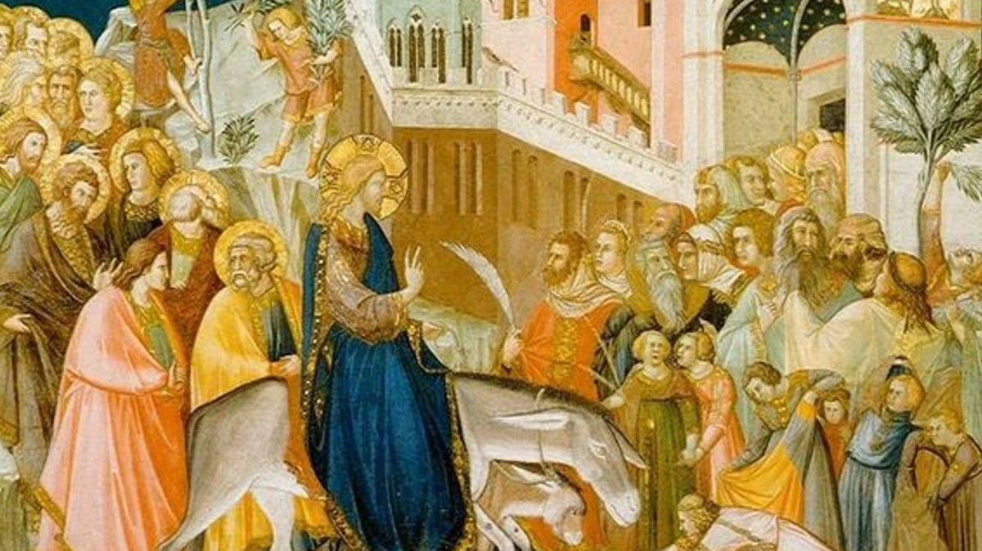
Between the Testaments
מָשִׁיחַ Messiah
Χριστός Christ
“Anointed One”

Slide 2
Do Jews and Christians worship the same God?

Slide 3
Messiah: NT Expectation
John 1:41 “One of the two who heard John speak and followed Jesus was Andrew, Simon Peter's brother. 41 He first found his own brother Simon and said to him, ‘We have found the Messiah’ (which means Christ).”
John 4:25-26 “The woman said to him, ‘I know that Messiah is coming (he who is called Christ). When he comes, he will tell us all things.’ 26 Jesus said to her, ‘I who speak to you am he.’”
Luke 3:15 “As the people were in expectation, and all were questioning in their hearts concerning John, whether he might be the Christ, 16 John answered them all, saying, ‘I baptize you with water, but he who is mightier than I is coming, the strap of whose sandals I am not worthy to untie. He will baptize you with the Holy Spirit and fire.’”

Slide 4
Messiah: NT Expectation
Matthew 16:13-16 “Now when Jesus came into the district of Caesarea Philippi, he asked his disciples, ‘Who do people say that the Son of Man is?’ 14 And they said, ‘Some say John the Baptist, others say Elijah, and others Jeremiah or one of the prophets.’ 15 He said to them, ‘But who do you say that I am?’ 16 Simon Peter replied, ‘You are the Christ, the Son of the living God.’”

Slide 5
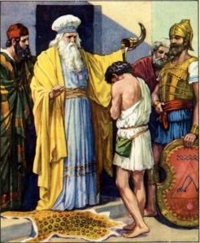
OT and IT: Who Is Messiah?
Messiah – Anointed One
Priest
King
Prophet
Chosen one (Cyrus, Isaiah 45:1)

Slide 6
OT: Who Is Messiah?
Genesis 3:15 (Protoevangelium)
I will put enmity between you and the woman,
and between your offspring and her offspring;
he shall bruise your head,
and you shall bruise his heel.
An individual
A descendent of human beings
Will crush Satan

Slide 7
OT: Who Is Messiah?
Genesis 49:10 Jacob blesses his sons
The scepter shall not depart from Judah,
nor the ruler's staff from between his feet,
until tribute comes to him;
and to him shall be the obedience of the peoples.
From the tribe of Judah
A ruler (scepter and obedience)
A receiver of tribute (a tributary)

Slide 8
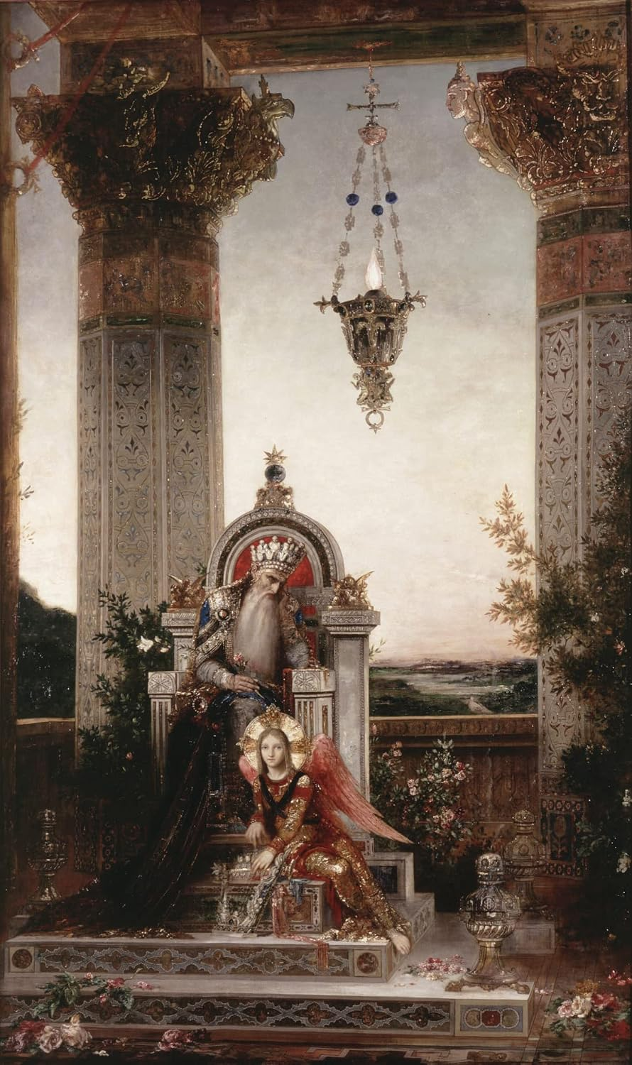
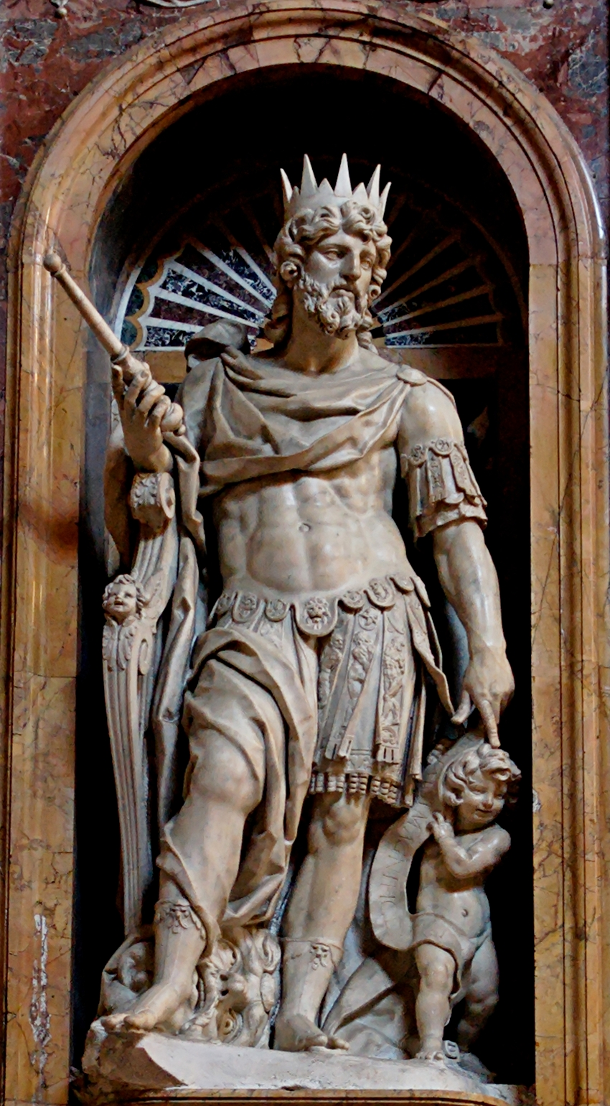
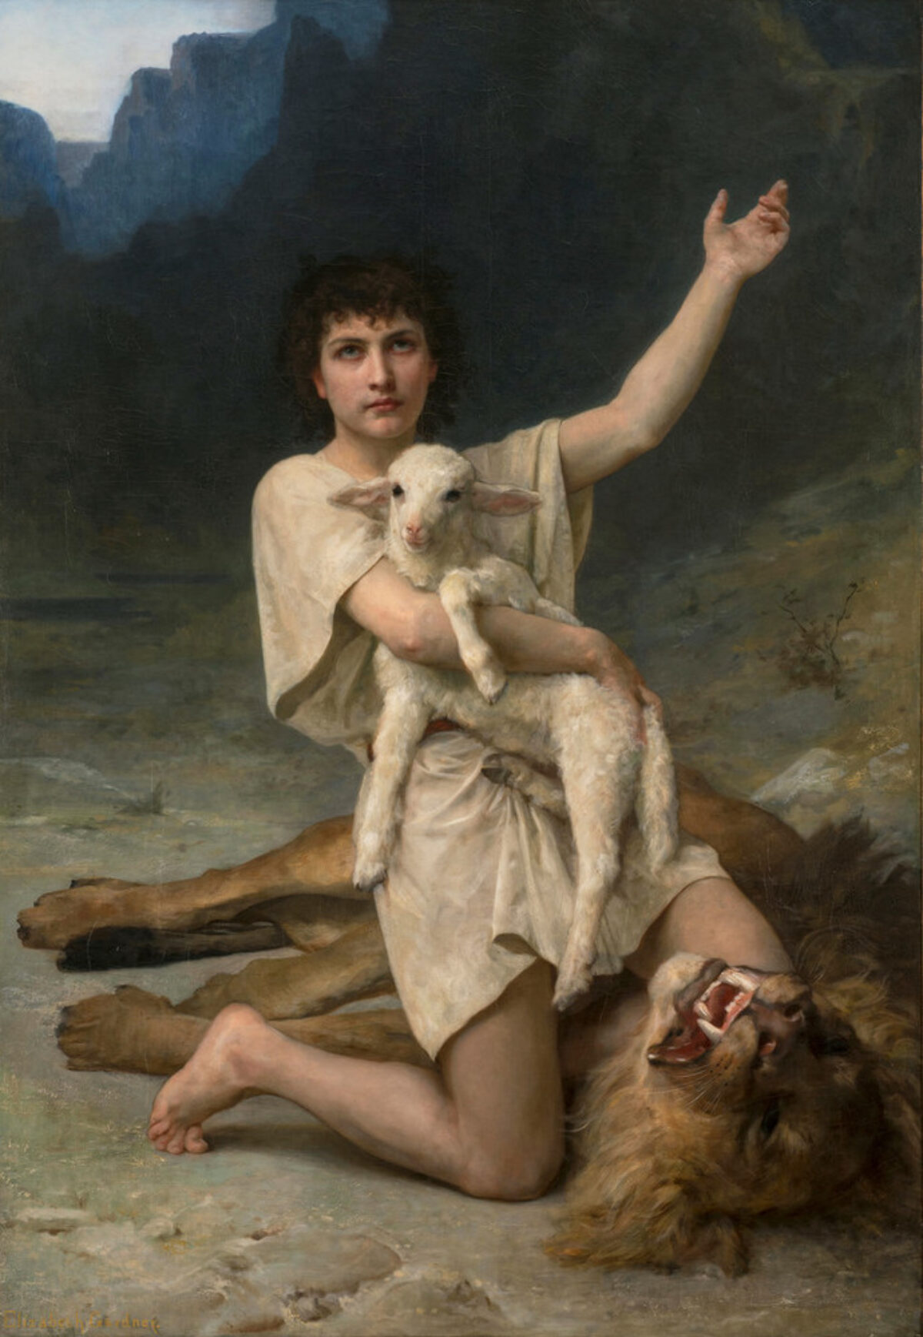
OT: Who Is Messiah?
A descendent of David
Associated with the eternal reign of David’s house
2 Samuel 7:8-17

Slide 9
OT: Who Is Messiah?
Receives a kingdom from his Father
Will defeat the evil nations
Will expand the kingdom through the world
Psalm 2:7-9 (Jesus’ Baptism and Transfiguration, Acts 13:33, Hebrews 1:5, Hebrews 5:5)
I will tell of the decree:
The Lord said to me, “You are my Son;
today I have begotten you.
8 Ask of me, and I will make the nations your heritage,
and the ends of the earth your possession.
9 You shall break them with a rod of iron
and dash them in pieces like a potter's vessel.

Slide 10
OT: Who Is Messiah?
Receives a kingdom
Receives a priesthood
3 Your people will offer themselves freely
on the day of your power,
in holy garments;
from the womb of the morning,
the dew of your youth will be yours.
4 The Lord has sworn
and will not change his mind,
“You are a priest forever
after the order of Melchizedek.”
Psalm 110:1-4 (Matt 22:44, Acts 2:34-35, Hebrews 1:13)
The Lord says to my Lord:
“Sit at my right hand,
until I make your enemies your footstool.”
2 The Lord sends forth from Zion
your mighty scepter.
Rule in the midst of your enemies!

Slide 11
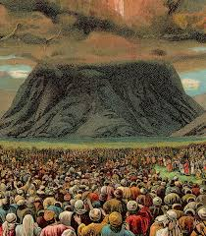
OT: Who Is Messiah?
Isaiah 53
God’s Chosen Servant
Innocent, but suffers on behalf of God’s people
His suffering heals God’s people

Slide 12
OT: Who Is Messiah?
Daniel 7:13-14
and behold, with the clouds of heaven there came one like a son of man,
and he came to the Ancient of Days and was presented before him.
14 And to him was given dominion and glory and a kingdom,
that all peoples, nations, and languages should serve him;
his dominion is an everlasting dominion, which shall not pass away,
and his kingdom one that shall not be destroyed.
Comes with the clouds (divine character)
Receives a kingdom
Son of man

Slide 13
IT: Who Is Messiah?
2 Esdras 13:1-13
“Figure of a man”
Comes up from the sea
Comes on the clouds of heaven
Defeats a multitude by his teachings

Slide 14
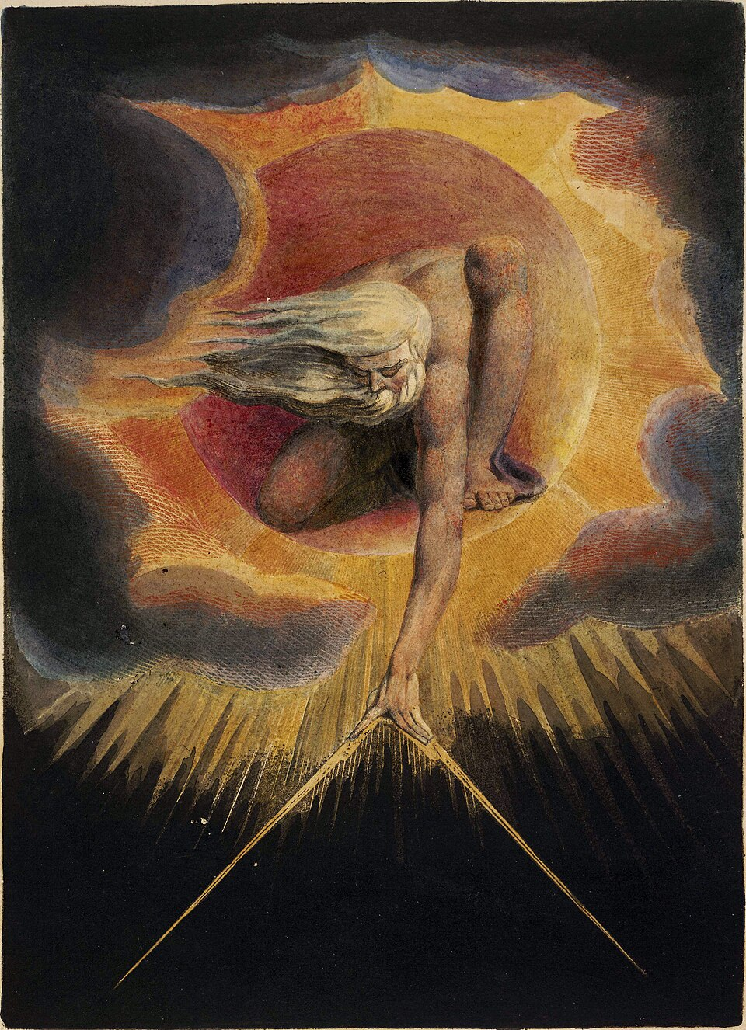
IT: Who Is Messiah?
1 Enoch 46
“Son of Man”
With the “Ancient of Days”
Possesses righteousness
Casts down the mighty from their thrones (ends evil tyranny)

Slide 15
The Messiah Revealed
Matthew 26:62-68
And the high priest stood up and said, “Have you no answer to make? What is it that these men testify against you?” 63 But Jesus remained silent. And the high priest said to him, “I adjure you by the living God, tell us if you are the Christ, the Son of God.” 64 Jesus said to him, “You have said so. But I tell you, from now on you will see the Son of Man seated at the right hand of Power and coming on the clouds of heaven.” 65 Then the high priest tore his robes and said, “He has uttered blasphemy. What further witnesses do we need? You have now heard his blasphemy. 66 What is your judgment?” They answered, “He deserves death.” 67 Then they spit in his face and struck him. And some slapped him, 68 saying, “Prophesy to us, you Christ! Who is it that struck you?”

Slide 16
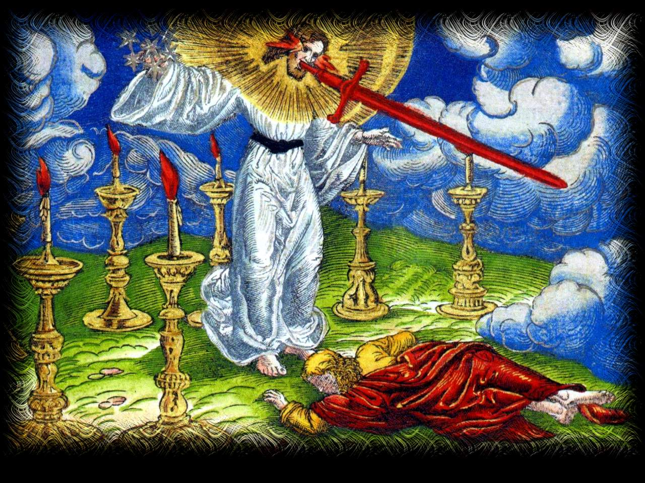
The Messiah Revealed
Revelation 1:9-20

Slide 17
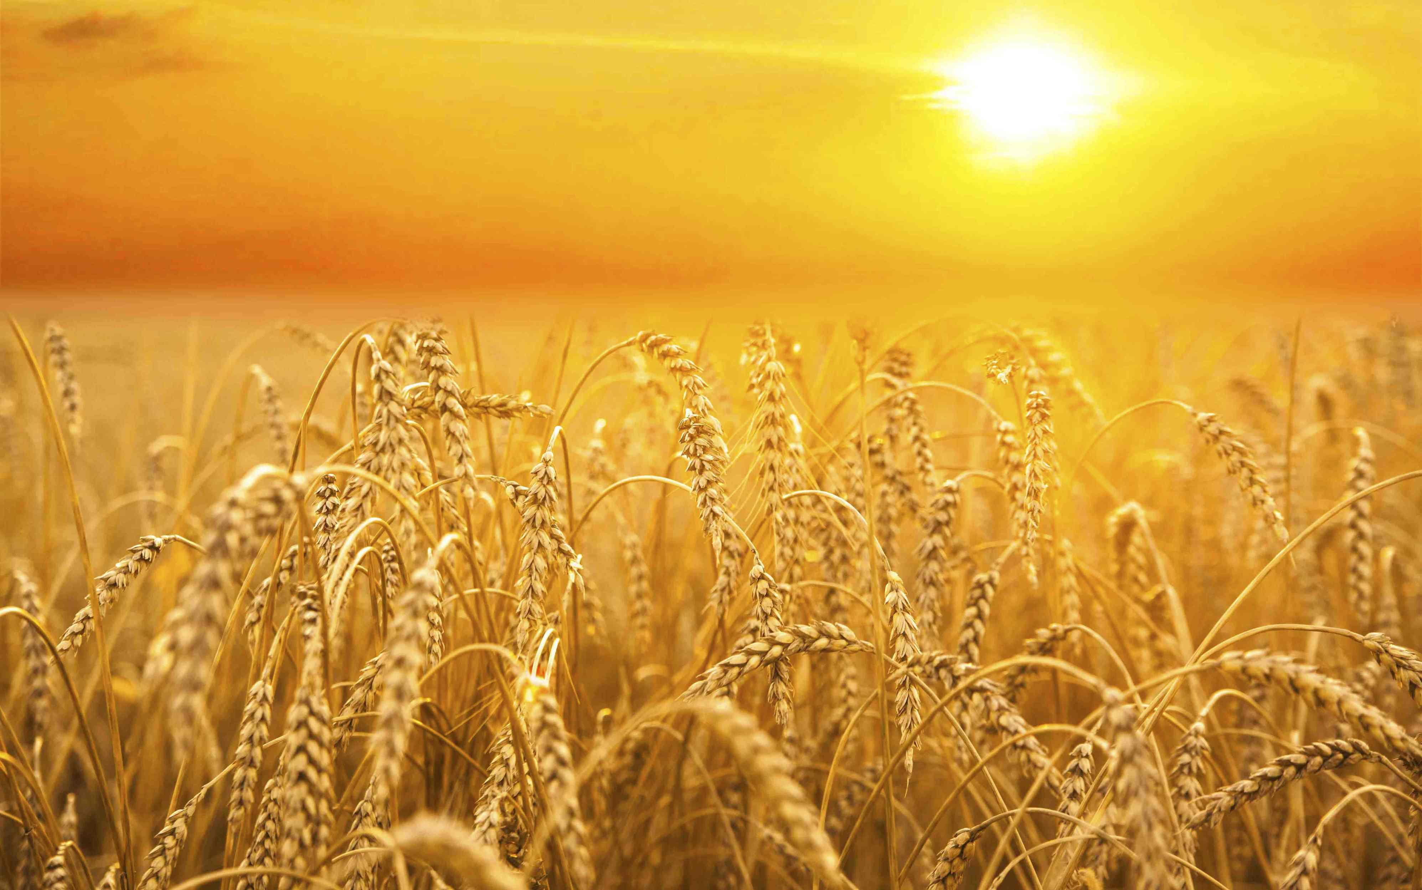
The Messiah Revealed
Revelation 14:14-16

Slide 18
An individual
A descendent of human beings
Will crush Satan
From the tribe of Judah
A ruler (scepter and obedience)
A receiver of tribute (a tributary)
A descendent of David
Associated with the eternal reign of David’s house
Receives a kingdom from his Father
Will defeat the evil nations
Will expand the kingdom through the world
Receives a priesthood
Comes with the clouds

Slide 19
Are Christians waiting? How is our waiting different from the waiting of the Jewish religion?

